Slide 1
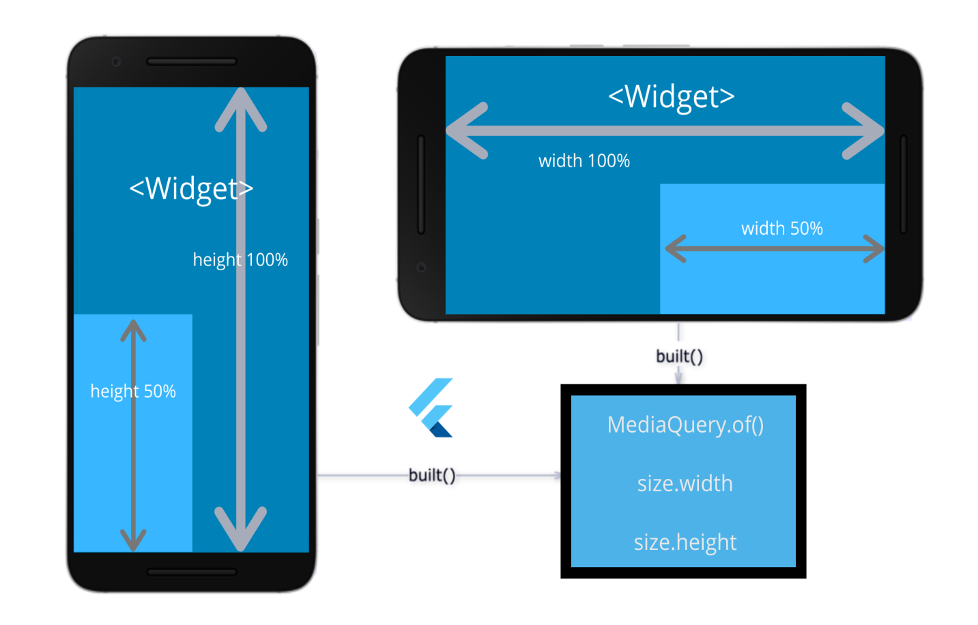
Mobile App Development using Flutter
Dept. of CS&E, MSRIT
Notes:
1

Slide 2
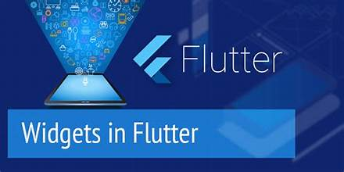
Contents For Week 3
Flutter alert dialogue
Flutter icons
Flutter images
Flutter lists
Flutter toast
Flutter themes
Flutter charts
Dept. of CS&E, MSRIT

Slide 3
Flutter Alert-Dialogue box
In Flutter, an alert dialog is a common user interface element used to display important messages, notifications, warnings, or requests for user input. Alert dialogs are a fundamental part of building user-friendly mobile applications. In this document, we'll cover the basics of creating an alert dialog in a Flutter app.
Creating alert dialogs is an essential skill when building Flutter applications. They help you communicate with your users, provide feedback, and request input. By following the steps outlined in this document, you'll be able to implement basic alert dialogs in your Flutter apps.
Steps to Create an Alert Dialog:
Import the necessary Flutter package (import 'package:flutter/material.dart’).
Define a function for showing the alert dialog using the showDialog function.
Call the function when a specific user interaction occurs, like tapping a button.
Customize the appearance and behavior of the alert dialog by modifying the AlertDialog properties, including title, content, and actions.
Dept. of CS&E, MSRIT

Slide 4
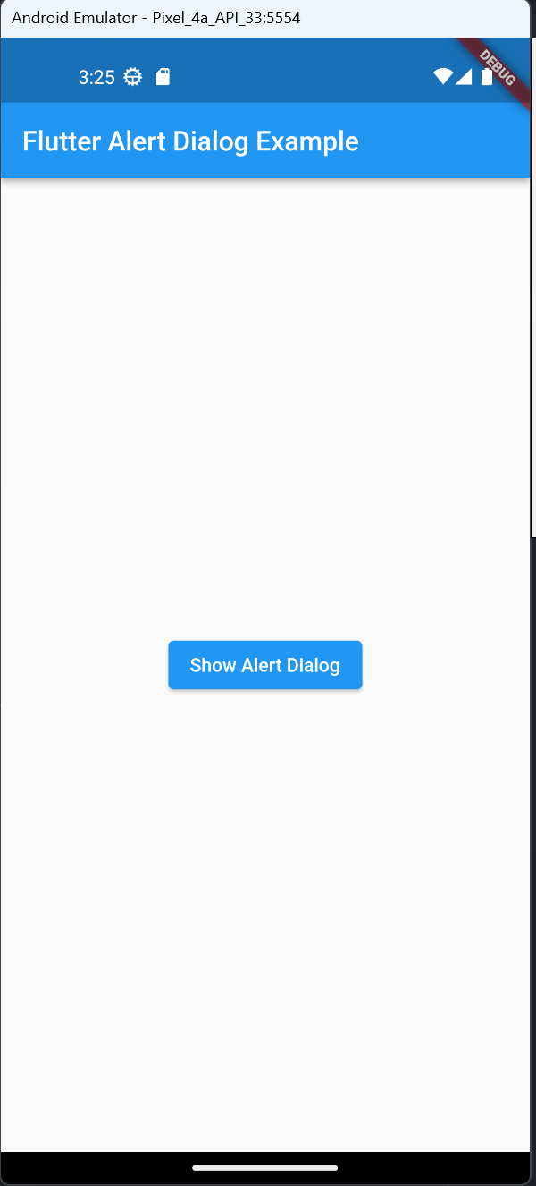
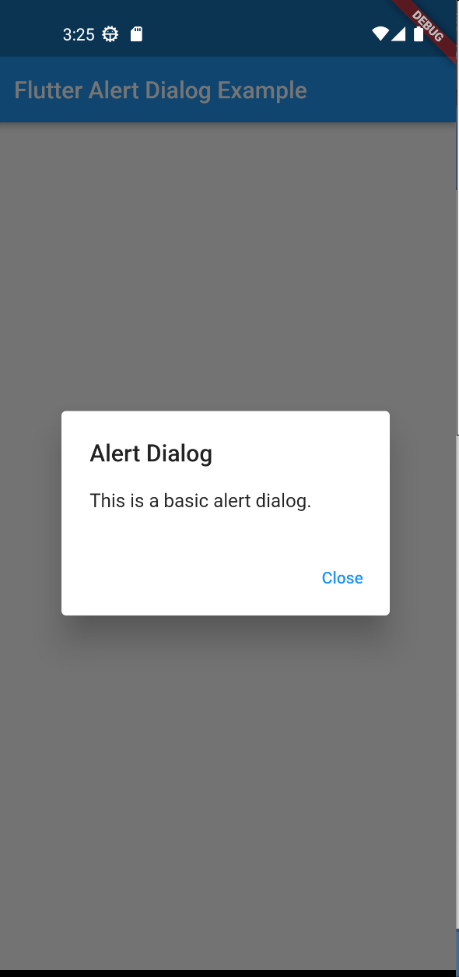
Flutter Alert-Dialogue box-Exercise1
Dept. of CS&E, MSRIT

Slide 5
Flutter Icons
Icons():
This section of the code demonstrates how to use the Icon widget to display different icons and control their appearance by adjusting properties such as size and color. Students can experiment with various icons and customize their size and colors as needed.
Each Icon is configured with specific properties to define its appearance:
Icons.star: The first icon is a star, indicated by Icons.star.
size: 100.0: The size property sets the size of the icon to 100.0 (adjustable to your preference).
color: Colors.yellow: The color property sets the color of the icon to yellow.
Icons.favorite: The second icon is a heart, displayed in red with a size of 100.0.
Icons.local_florist: The third icon represents a local florist or flower, displayed in green with a size of 100.0.
Each Icon is followed by a Text widget that provides a simple label for the respective icon.
Flutter provides a rich collection of icons, including Material Design and Cupertino icons, making it easy to incorporate a variety of visual elements into your mobile app's user interface. These icons are vector-based, ensuring they scale gracefully across different screen sizes and resolutions.
Flutter also allows for custom icon design and encourages consistency in UI design, whether you're building for Android or iOS.
With the flexibility to customize size, color, and accessibility labels, Flutter icons play a crucial role in creating aesthetically pleasing and user-friendly mobile applications.
Dept. of CS&E, MSRIT

Slide 6
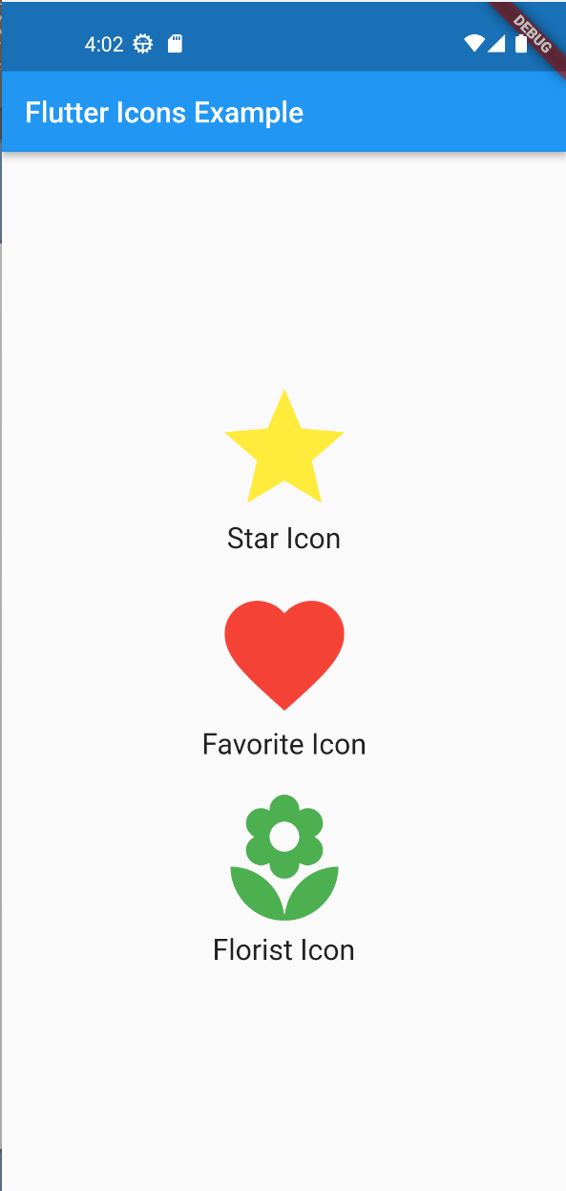
Flutter Icons-Exercise2
Dept. of CS&E, MSRIT

Slide 7
Flutter Images
Steps to use Flutter Image Widget():
Import the Necessary Package: Begin by importing the package:flutter/material.dart package, which includes the Image widget.
Define the Image: Within your widget tree, use the Image widget. Specify the image source, which can be a local asset, network URL, or memory buffer, using the Image.asset, Image.network, or Image.memory constructor, respectively.
Customize Image Properties: Adjust properties such as width, height, fit, and alignment to control the image's appearance and positioning.
Include Image Assets: If you're using local assets, make sure to configure them in your pubspec.yaml file. This ensures that the assets are recognized and included in your Flutter project.
Display Images: Place the Image widget within your app's layout, typically within a Scaffold or other appropriate container widget.
Flutter provides a versatile Image widget that enables developers to display images in various formats and sources within their applications. With the Image widget, you can effortlessly integrate local and network images into your Flutter app's user interface.
This widget supports common image formats like PNG, JPEG, GIF, and more. It offers flexibility in resizing, fitting, and customizing images to meet your design and layout requirements.
Whether it's displaying product images, user avatars, or icons, the Image widget is an essential tool for enhancing the visual appeal and user experience of your Flutter app.
Dept. of CS&E, MSRIT

Slide 8
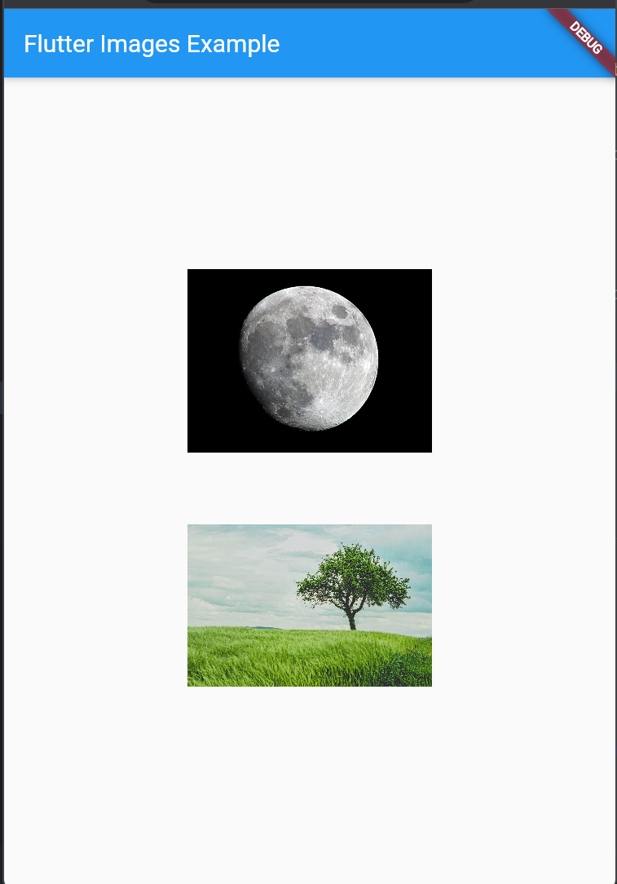
Flutter Images-Exercise-3
Dept. of CS&E, MSRIT

Slide 9
Flutter List
Steps to use Flutter Lists Widget():
Import the Necessary Package: Begin by importing the package:flutter/material.dart package, which includes the essential widgets for creating lists.
Define List Data: Prepare your data source, which can be a simple list of items or more complex data structures, depending on your app's needs.
Select the List Widget: Choose between the ListView and ListView.builder widgets based on the nature of your list. Use ListView for finite lists or ListView.builder for dynamic or large lists.
Configure the List: Customize the list by setting properties like itemCount, itemBuilder, and others as needed. These properties control the appearance and behavior of the list.
Create List Items: Implement the logic for rendering each list item in the itemBuilder function, returning a widget that represents the item.
Display the List: Place the list widget within your app's layout, typically within a Scaffold or other appropriate container widget
Lists in Flutter are versatile and can be used to display a wide range of data, from simple text items to complex custom widgets.
Flutter offers two main types of lists: ListView and ListView.builder. The ListView widget is used for finite lists where you know the number of items in advance, while the ListView.builder widget is perfect for dynamic lists with a large or unknown number of items.
Lists are highly customizable, allowing you to control the layout, appearance, and interactions of the items. Whether you're building a simple to-do list or a complex news feed, Flutter's list widgets provide the flexibility and performance needed to create a seamless user experience
Dept. of CS&E, MSRIT

Slide 10
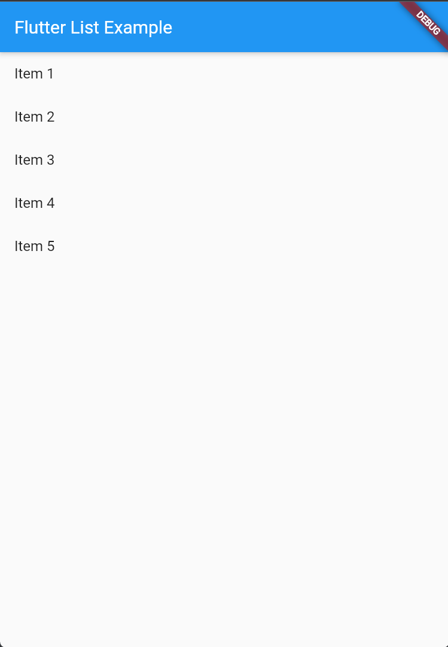
Flutter List-Exercise-4
Dept. of CS&E, MSRIT

Slide 11
Flutter Toasts
Toast Messages for User Feedback: Flutter toasts are a UI component used to provide non-intrusive feedback or information to users. They are often used to display short-lived messages or notifications at the bottom of the screen. Toasts are especially useful for showing temporary messages, such as success messages, warnings, or errors, without disrupting the user's experience.
Built-in Flutter Toasts: Flutter provides built-in support for displaying toast messages without the need for external libraries. You can use the SnackBar widget within a Scaffold to show simple toast-like messages. Flutter's native approach ensures consistent design and behavior across different platforms.
Customization and Third-Party Packages: While Flutter's built-in toasts are simple and effective, you can customize their appearance and behavior to match your app's design. Additionally, there are third-party packages available, such as fluttertoast, that offer more advanced customization and features for displaying toasts, including different positions, durations, and styles, to enhance the user experience in your Flutter app.
Steps to use Flutter Toasts:
Create a Flutter Project: Create a new Flutter project if you haven't already.
Replace main.dart: Replace the content of the default main.dart file with the provided Flutter toast code.
Run the App: Use the flutter run command in the project directory to build and run the Flutter app on an emulator or physical device.
Interact with the App: When the app is running, click the "Show Toast" button to trigger the toast message.
Dept. of CS&E, MSRIT

Slide 12
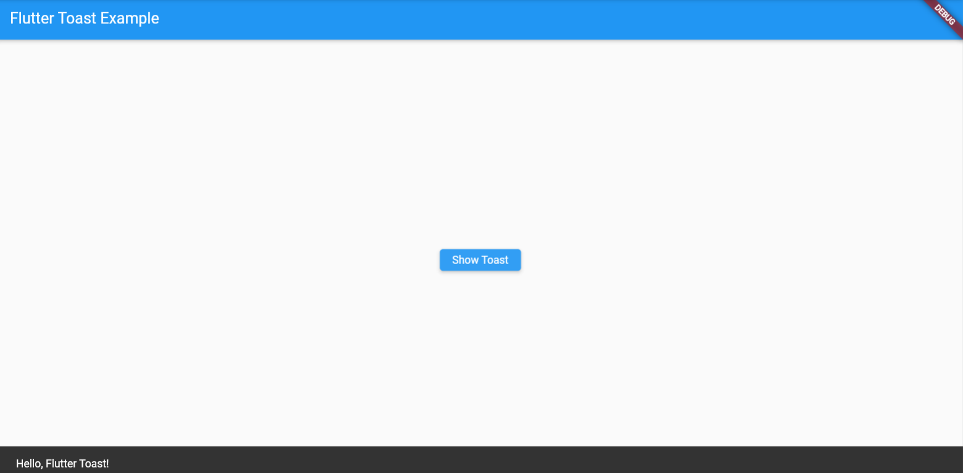
Flutter Toasts-Exercise-5
Dept. of CS&E, MSRIT

Slide 13
Flutter Themes
Flutter themes allow you to maintain a consistent design and branding throughout your app. By defining a theme, you can specify the primary and accent colors, typography, and other visual properties that represent your app's identity. This consistency helps in creating a professional and cohesive user experience.
Flutter themes make it easy to implement dark and light mode support in your app. With just a few lines of code, you can switch between light and dark themes based on user preferences or system settings, ensuring optimal readability and user comfort in different lighting conditions.
Themes in Flutter are highly customizable. You can create and reuse theme objects with specific color schemes, fonts, and other design elements tailored to different sections of your app. This allows you to easily maintain a coherent visual style while adapting to various parts of your application.
Steps to use Flutter Themes:
Create a Theme: Define a custom theme using the ThemeData class with desired design properties.
Wrap Your App with Theme: Wrap your app with a Theme widget and provide the custom theme inside the MaterialApp.
Access Theme Properties: Access theme properties within widgets using Theme.of(context).
Dept. of CS&E, MSRIT

Slide 14
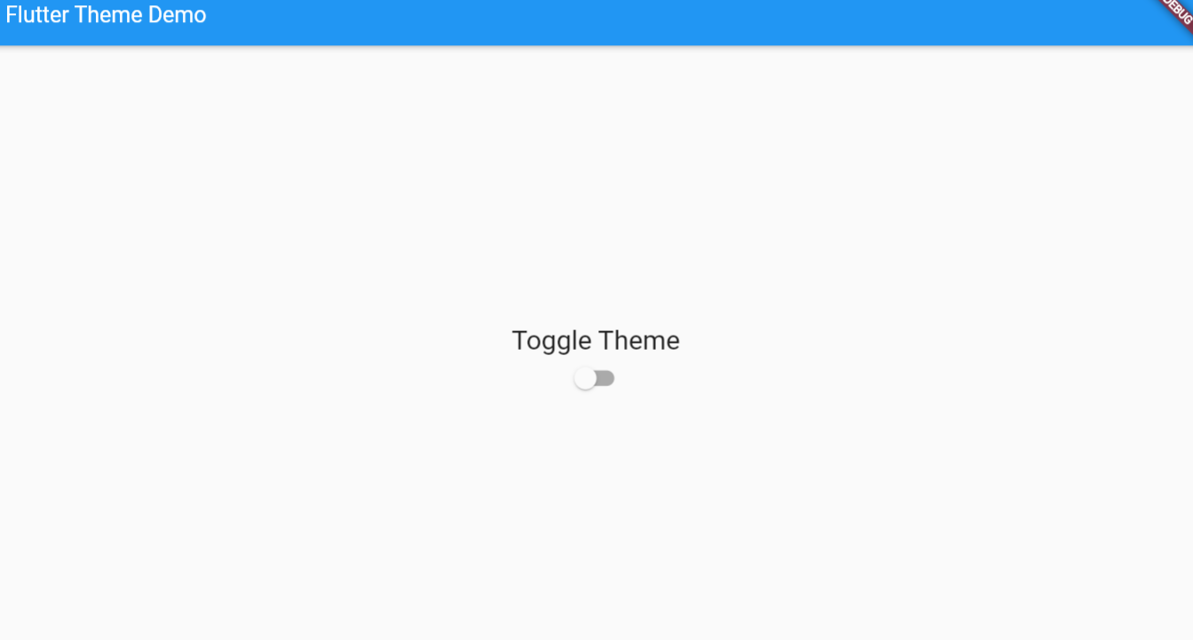
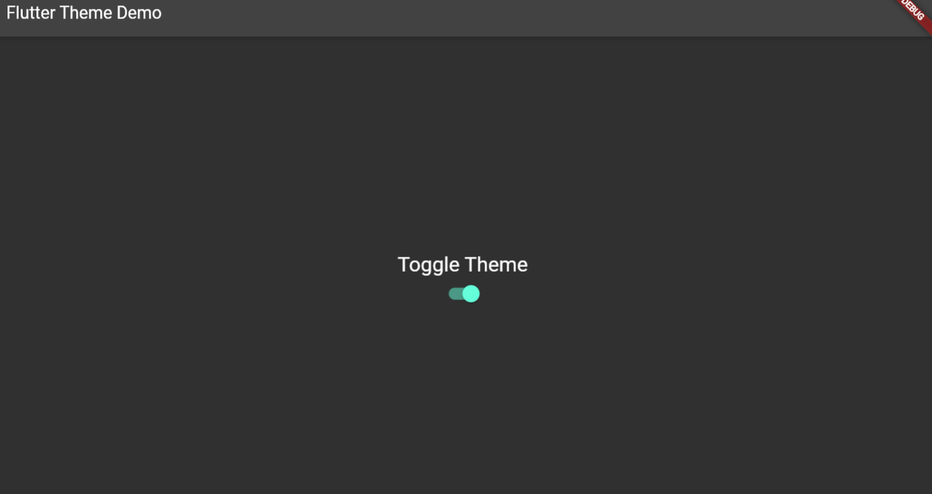
Flutter Themes-Exercise-6
Dept. of CS&E, MSRIT

Slide 15
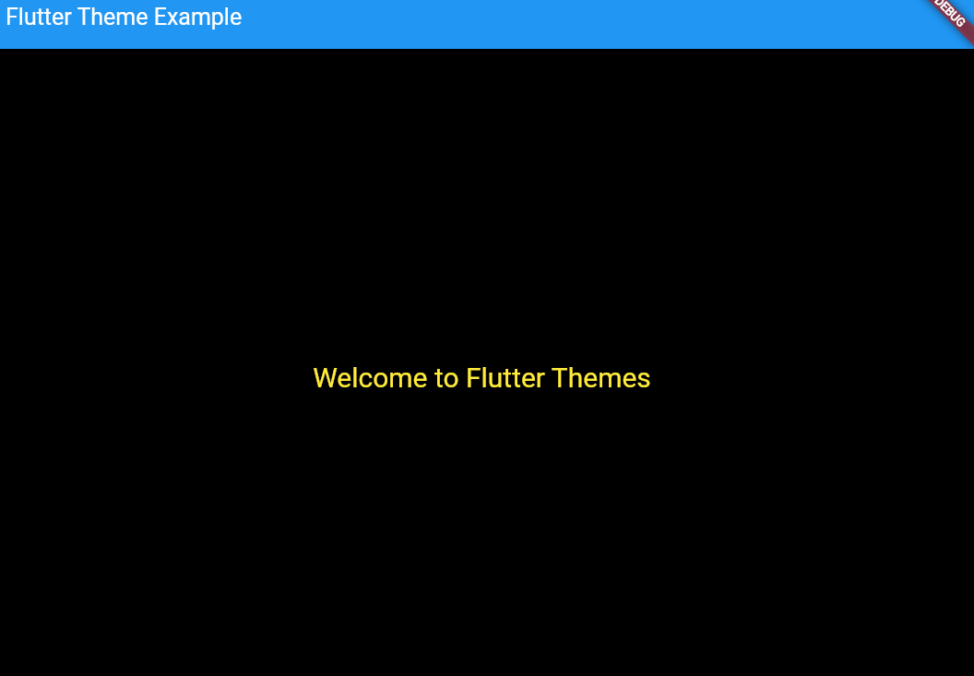
Flutter Themes Custom-Exercuse-6
Dept. of CS&E, MSRIT

Slide 16
Flutter Charts
Steps to use Flutter Charts:
Import Required Libraries: Ensure that you have imported the necessary libraries for using charts.
Change the pubspec.yaml file: Add the dependencies dependencies:
fl_chart: ^0.41.0
flutter:
sdk: flutter
Create a Flutter App Structure: Organize your Flutter app by creating the app structure, which includes a main app class (MyApp) and the home page class (MyHomePage). In your code, MyApp is the entry point for your app.
Define a MaterialApp: Inside the MyApp class, define a MaterialApp widget, which acts as the root widget for your app. This is where you specify the theme, home page, and other app-level settings.
Create a Scaffold with AppBar: In your MyHomePage class, create a Scaffold widget. The Scaffold provides the basic app structure, and the AppBar widget defines the top app bar with a title.
Add a Chart Widget: Within the Scaffold, include the chart widget, which is a PieChart in this case. You configure the chart by providing data in a PieChartData object. Customize the chart data to fit your specific data and design requirements.
Customize Chart Data: Configure the PieChartData object to represent your data and customize the appearance of the pie chart. In this code, you specify the sections with colors, values, and titles for each category.
Flutter charts are essential for data visualization in mobile applications. They allow you to represent complex data in a graphical format, making it easier for users to understand and interpret information. Flutter offers various chart types, including line charts, bar charts, pie charts, and more, to suit different data visualization needs.
Flutter charts are highly customizable. You can tailor the appearance of charts to match your app's design and branding. This includes adjusting colors, fonts, labels, gridlines, and other visual elements. Customization options enable you to create charts that align with your app's unique look and feel.
Flutter charts support user interaction, such as tapping or swiping on data points, zooming in on specific sections, or displaying tooltips with additional information. Interactive charts enhance the user experience and provide a dynamic way for users to explore data.
Dept. of CS&E, MSRIT

Slide 17
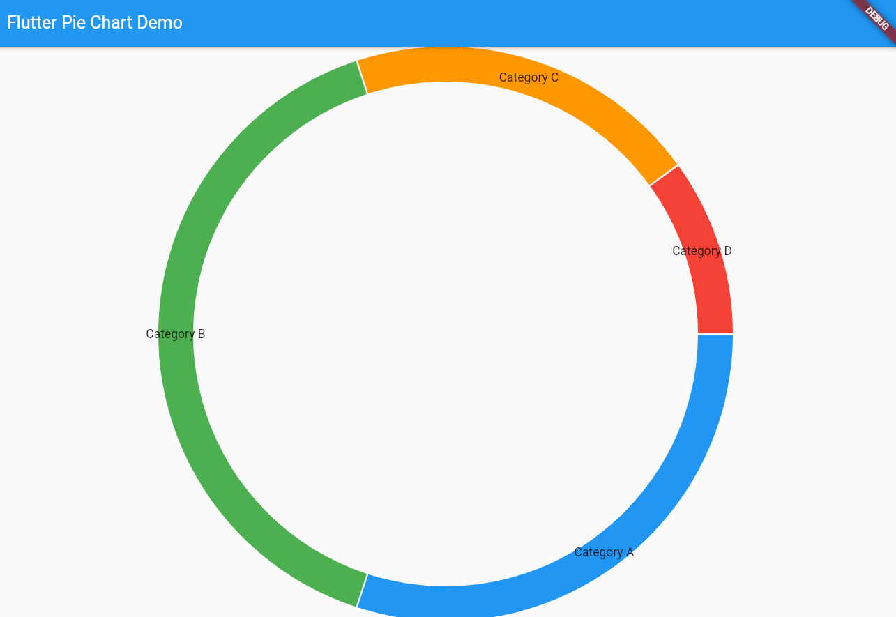
Flutter Charts-Exercise-7
Dept. of CS&E, MSRIT

Slide 18
Practical's
Dept. of CS&E, MSRIT

